Slide 1
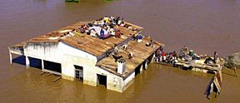
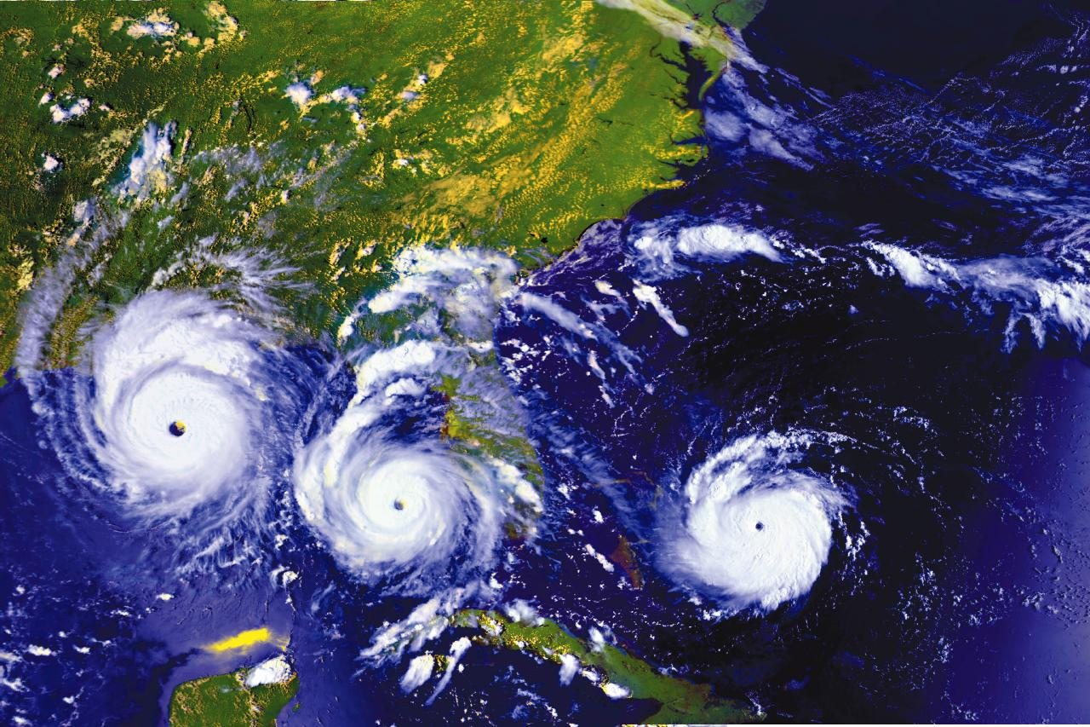
Climate Change and Extreme Events Heat-Precipitation – Floods-Drought
Gordon McBean, CM, OOnt, PhD, FRSC
Professor Emeritus, Western University, London, Canada
Institute for Catastrophic Loss Reduction
Presentation to: ICFM Webinar #9
Changes in Climate Extremes and their Impacts on Floods and Droughts”

Slide 2
Strong Scientific Programs for Climate– Science to Policy to Actions
IGY
1957-8
1967 1980
1980
To determine:
predictability of climate; and effects of human activities on climate.
Global Atmospheric Research Program
1st World Climate Conference - 1979
Future
Earth
2015
1987
1991
Research on climate change mechanisms that are affecting extreme weather conditions.
1996
Human
2008
Hyogo Framework - 2005
Indian Ocean
Tsunami - 2004
2012
1992

Slide 3
Intergovernmental Panel on Climate Change - IPCC
IPCC
Created in 1988 - to assess and synthesize the policy-relevant results of peer reviewed published research and other credible and open sources;
The IPCC is structured with three Working Groups:
Working Group I - examines the physical science, contributing to an ever-strengthening understanding of how the climate system works, and how it is changing in response to human activity.
Working Group II - assesses the impacts, adaptation and vulnerabilities;
Working Group III focuses on climate change mitigation,
Question: has the climate changed and is the change due to human activities?
Fifth Assessment Report (AR5, 2013-14): “It is extremely likely that human influence has been the dominant cause of the observed warming since the mid-20th century.”

Slide 4
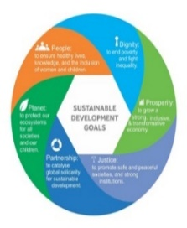
Strong Scientific Programs for Climate– Science to Policy to Actions
1980’s – science statements on changing climate
IGY
1957-8
1967 1980
1980
Global Atmospheric Research Program
1st World Climate Conference - 1979
Global
Agenda
2030
UN Climate Convention
Paris Agreement
2015
Kyoto Protocol
IPCC-1988
Future
Earth
2015
1987
AR2
AR5
AR1
1991
2nd World Climate Conference - 1990
1996
Human
2008
Earth Summit
UNFCCC - 1992
Hyogo Framework - 2005
Indian Ocean
Tsunami - 2004
2012
1992

Slide 5
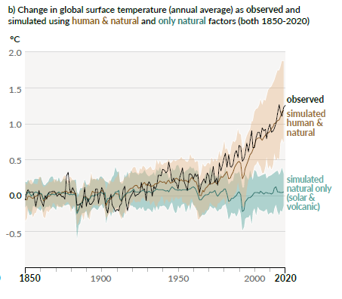
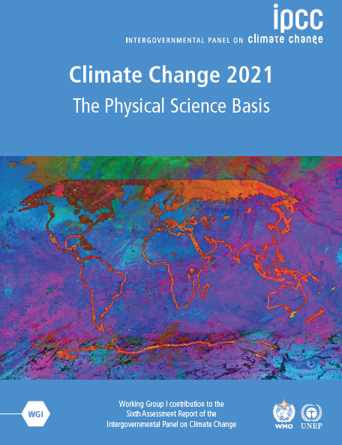
9 August 2021
Sixth Assessment Report
AR6
Global surface temperature has increased faster since 1970 than in any other 50-year period.
CO_{2,} CH_{4,} N₂O concentrations - higher than at any time in at least 800,000 years.
0.2ºC/decade
It is unequivocal that human influence has warmed the atmosphere, ocean and land. Widespread + rapid changes in atmosphere, ocean, cryosphere and biosphere have occurred.
Human-induced climate change is already affecting many weather and climate extremes.
Heatwaves, heavy precipitation, droughts, and tropical cyclones.

Slide 6
Current State of the Climate
Human-induced climate change is already affecting many weather and climate extremes in every region across the globe. Evidence of observed changes in extremes such as heatwaves, heavy precipitation, droughts, and tropical cyclones, and, in particular, their attribution to human influence, has strengthened since the Fifth Assessment Report (AR5).
Climate change is already affecting every inhabited region across the globe, with human influence contributing to many observed changes in weather and climate extremes

Slide 7
Observed Changes in Hot Extremes and Heavy Precipitation
Hot Extremes
Human Contribution
Heavy Precipitation
Human Contribution

Slide 8
Climate Change Projections – Scenarios Human activities affect all the major climate system components, with some responding over decades and others over centuries.
Global surface temperature change relative to 1850-1900
Global mean sea-level change relative to 1900
Global surface temperature will continue to increase until at least the mid-century under all emissions scenarios considered. Global warming of 1.5°C and 2°C will be exceeded during the 21st century unless deep reductions in greenhouse gas emissions occur soon.
Low-likelihood-high impact – ice-sheet instability

Slide 9
With every increment of global warming, changes get larger in regional mean temperature.
Observed and Simulated Change 1ºC warming
Annual Mean T Change (ºC) relative to 1850-1900
Simulated Change 1.5ºC 2ºC 4ºC warming

Slide 10
With every increment of global warming, changes get larger in regional mean precipitation.
Simulated Change 1.5ºC 2ºC 4ºC warming

Slide 11
Climate Futures
Many changes become larger in direct relation to increasing global warming - increases in the frequency and intensity of hot extremes, and heavy precipitation, agricultural and ecological droughts in some regions, and proportion of intense tropical cyclones, as well as reductions in Arctic sea ice, snow cover and permafrost.
Continued global warming is projected to further intensify the global water cycle, including its variability, global monsoon precipitation and the severity of wet and dry events.

Slide 12
Projected changes in extremes are larger in frequency and intensity with every additional increment of global warming
Hot Temperature Extremes Over Land
10-year event 50-year event
Heavy Precipitation Over Land
10-year event
Frequency
Frequency
1 2.8 4.1 5.6 9.4
1 1.3 1.5 1.7 2.7
Intensity
Intensity
1 1.2 2 2.6 5.1 ºC
1 7% 11% 14% 30%

Slide 13
Projected changes in extremes are larger in frequency and intensity with every additional increment of global warming
Hot Temperature Extremes Over Land
10-year event
Agricultural & ecological droughts in drying regions
10-year event
Frequency
1 2.8 4.1 5.6 9.4
Frequency
1 1.7 2.0 2.4 4.1
Intensity
Intensity
0 0.3 0.5 0.6 1.0 SD
1 1.2 2 2.6 5.1 ºC

Slide 14
Climate Information for Risk Assessment and Regional Adaptation
The heavy and sustained rainfall events responsible for most inland flooding are becoming more intense in many areas as the climate warms because air near Earth’s surface can carry around 7% more water in its gas phase for each 1°C of warming. This extra moisture is drawn into weather systems, fueling heavier rainfall .
With further global warming, every region is projected to increasingly experience concurrent and multiple changes in climatic impact-drivers. Changes in several climatic impact-drivers would be more widespread at 2°C compared to 1.5°C global warming and even more widespread and/or pronounced for higher warming levels.
A warming climate also affects wind patterns, how storms form and evolve, and the pathway those storms usually travel. Warming also increases condensation rates, which in turn releases extra heat that can energize storm systems and further intensify rainfall.
On the other hand, this energy release can also inhibit the uplift required for cloud development, while increases in particle pollution can delay rainfall but invigorate storms.
Low-likelihood outcomes, such as ice sheet collapse, abrupt ocean circulation changes, some compound extreme events and warming substantially larger than the assessed very likely range of future warming cannot be ruled out and are part of risk assessment.

Slide 15
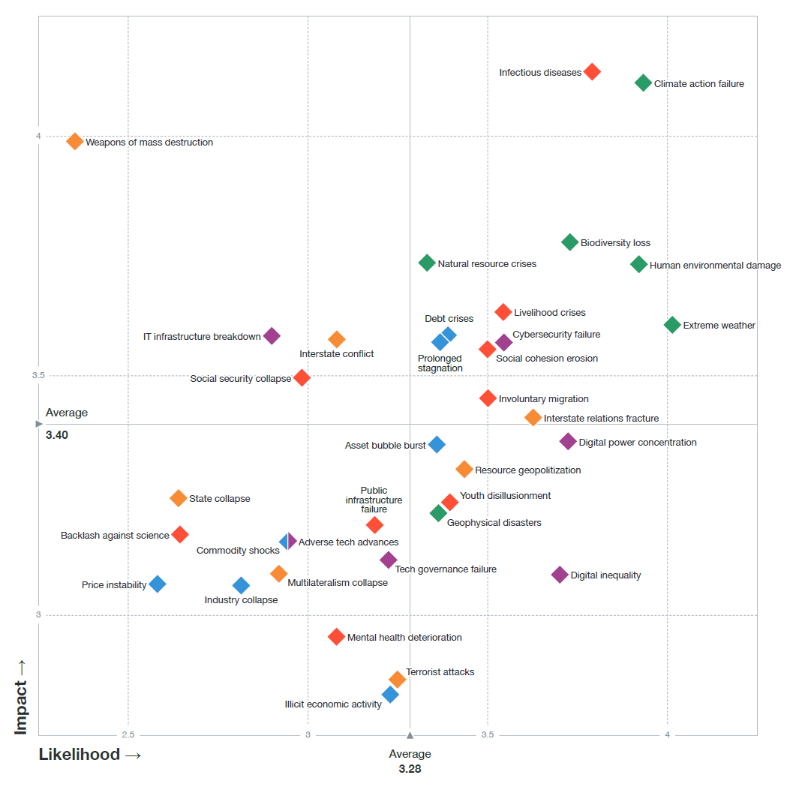
A global risk - significant negative impact for several countries or industries within the next 10 years – to 2030.
Global Risk Report 2021
Infectious Diseases (2021)
Climate Action Failure
Weapons of Mass Destruction
HIGH
Biodiversity Loss
Human
Environmental Damage
food, water Crises
Extreme Weather
Impact
Livelihood crises
Social cohesion erosion
Involuntary migration
Public infrastructure failure
Climate, Environmental and Societal Risks Connected
Likelihood
HIGH
World Economic Forum - Global Risk Assessments
Extreme Weather Events: cold fronts, fires, floods, heat waves, windstorms etc.

Slide 16
Integrated Research
on Disaster Risk
An integrated approach to research on disaster risk through: an international, multidisciplinary (natural, social, health, engineering, … sciences) collaborative research programme. - Objectives:
1. Characterisation of hazard, vulnerability and risk.
1.1 identifying hazards and vulnerabilities leading to risks; Forensic Investigations - FORIN - Disaster Loss DATA
1.2 forecasting hazards and assessing risks; and
1.3 dynamic modelling of risk.
2. Effective decision-making in complex and changing risk context. Risk interpretation to Action
2.1 identifying relevant decision-making systems and their interactions;
2.2 understanding decision-making in the context of environmental hazards;
2.3 improving the quality of decision-making practice
3. Reducing risk and curbing losses through knowledge-based actions.
3.1 Vulnerability assessments
3.2 Effective approaches to risk reduction
International Centres of Excellence (18)
Assessment of Integrated Research on Disaster Risk (AIRDR)

Slide 17
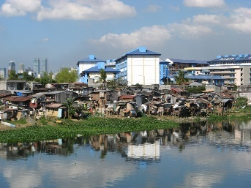
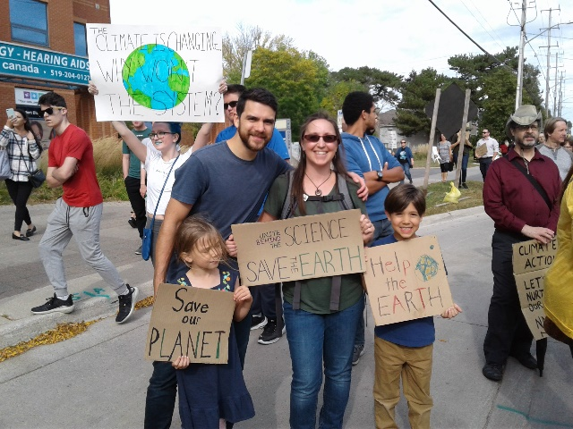
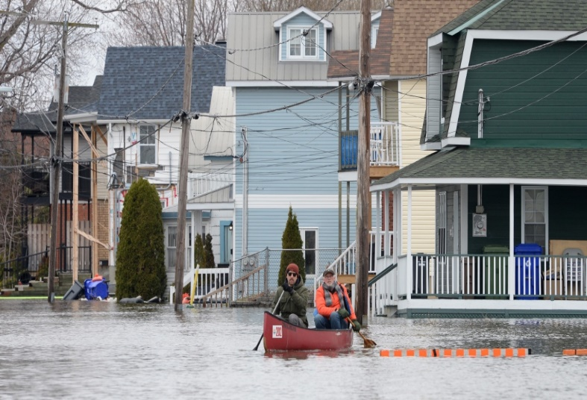
Meeting the Flooding Challenges
ACTION
Unite Behind the SCIENCE
SAVE THE EARTH
Comprehensive Actions Needed – Thank you for your Actions.

